Slide 1
Basic Clinical Trials Design Aug 13, 2013
TCS Internal
1

Slide 2
Clinical Trial Phases: Phase I
Phase I [small number of healthy volunteers; in certain cases, i.e., virology/oncology, also patients]
Goal: to understand what happens to the investigational compound in the body from the time it is swallowed or injected until it is excreted, when it is excreted and how the human body reacts to the new compound from a safety and tolerability point of view.
Study participants are monitored for the occurrence and severity of any side effects that they may experience.

Slide 3
Clinical Trial Phases: Phase II
Phase II
Goal: to evaluate the safety and efficacy of an investigational compound in patients with a specific disease or condition.
Typically conducted in a group of patients who are at the same stage of a disease.
Patients are given various doses of the compound and closely monitored to compare the effects and to determine the safest dosing regimen.
In many instances, multiple Phase II studies are conducted to test the compound in a variety of patient populations or indications.

Slide 4
Clinical trial phases: Phase III
Phase III
Goal: To confirm the safety and efficacy of an investigational compound, and the dosage regimen chosen, in large numbers of patients with a specific disease or condition.
The safety and efficacy of the investigational compound is compared to that of the currently accepted standard treatment or Placebo.
Information obtained from Phase III studies is used to determine how the compound is best prescribed to patients in the future.
The complete information available on the new compound is submitted to Health Authorities.

Slide 5
Clinical Trial Phases: Phase IV
Phase IV
Phase IV studies take place after the drug has been approved for marketing
These studies are designed:
to provide broader experience in evaluating the safety and effectiveness of the new drug in larger numbers of patients, subpopulations of patients, and to compare and/or combine it with other available treatments.
to evaluate the long-term effects of the drug. Under these circumstances, less common adverse events may be detected.

Slide 6
Clinical Trial Protocol
Each clinical trial has a master plan called a protocol.
This plan explains how the trial will work.
The protocol outlines what will be done during the clinical trial and why. Each medical center that does the study uses the same protocol.
Key information in a protocol includes:
Purpose and the study objectives of the trial
How many patients will take part in the clinical trial
Who is eligible to take part in the clinical trial
What tests patients will get and how often they will get them
What type of data will be collected during the clinical trial
Detailed information about the treatment plan

Slide 7
Study Goals: Objectives and Hypotheses
Define objectives of the study
State hypotheses
Specific statements about the effects of the treatment(s) being tested
Requires clinical and statistical input. Criteria for successful trial must be pre-defined based on scientific rational and must be convincing to a regulatory agency
Choose primary objective and hypothesis
Study can be designed well to answer one question
Primary question dictates the optimal design and sample size of the trial

Slide 8
Study Goals: Objectives and Hypotheses
Superiority
To show test drug is better than control
Most Phase II/III drug trials
Non-inferiority/equivalence
To show test drug is no worse than or similar to marketed drug
New drug has additional advantages compared to marketed drug (safety, cost, etc.)

Slide 9
Study Goals: Primary Endpoints
Example: In oncology trials, endpoints are
Overall Survival (OS)
Progression Free Survival (PFS)
Time to Progression (TTP)
Objective response rate
The measure which can provide the best evidence directly related to the primary objective and hypothesis
A single primary endpoint should be identified to answer the primary question
Acceptable precision

Slide 10
Study Goals: Secondary Endpoints
Address other questions of interest
Show robustness of primary result
Help in interpretation of primary result
Clinically important endpoints with only a modest chance of detecting a positive result (e.g., mortality in a lipid reduction trial)

Slide 11
Study Planning
Potential issues with clinical trials
Bias
Confounding
Control bias and confounding
Concurrent controls
Randomization
Blinding
Study Designs
Type I and Type II errors
Sample Size and Power

Slide 12
Study Planning: Study Designs
Select a study design which will allow us to draw valid statistical conclusions from the data (i.e., avoids bias and confounding)
Two common study designs are
Parallel
Crossover

Slide 13
Study Planning: Parallel Group Designs
Experimental Treatment
Assess Endpoints
Participants screened for entry criteria
Control Treatment
Assess Endpoints
Screening
Baseline
Treatment
Time

Slide 14
Study Planning: Crossover Designs
Experimental Treatment
Assess Endpoint
Experimental Treatment
Assess Endpoint
Participants screened for entry criteria
Control Treatment
Assess Endpoint
Control Treatment
Assess Endpoint
Screening
B/L
Treatment (Period 1)
{Washout}
Treatment (Period 2)

Slide 15
Study Planning: Crossover Designs
Each subject is randomized to a sequence of treatments with a wash-out period between treatments
Each subject serves as his/her own control
Eliminates between-subject variation

Slide 16
Study Planning: Crossover Designs
Needs smaller sample size than parallel designs
Wash-out period needs to be long enough so that there is no carryover effect
Not appropriate when
Treatment period is long
Treatment intended to be curative
Washout period is long (drugs with long half-life)
Carryover exists

Slide 17
Study Planning: Designs
 | Parallel Design | Crossover Design
Length | Shorter | Longer
Sample Size | Larger | Smaller
Precision of Estimates | Less | More
Endpoints/ Diseases | Most | Some

Slide 18
Interpretation of Results

Slide 19
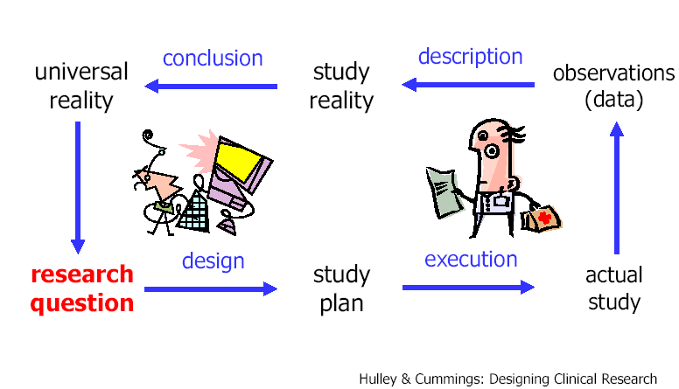
The Ideal Research Process

Slide 20
“The extent to which the findings of a clinical trial can be reliably extrapolated from the patients who participated in the trial to a broader patient population and a broader range of clinical settings” ICH E9.
Generalizability
Generalize?
Population
Sample
Sample vs. Target Population
Analysis Sets

Slide 21
Generalizability: Sample vs. Target Population
The target population is the group to which the researcher would like to generalize his or her results.
In confirmatory trials, the subjects in the trial should more closely mirror the target population
Representativity:
To a high degree in confirmatory trials (phase III).
To a lesser degree in early phase trials.

Slide 22
Generalizability: Achieving Sample Representativity
Randomization:
Eliminates selection bias
Balances arms with respect to prognostic variables (known and unknown)
Forms the basis for statistical tests
Is there a true randomization?
Centers/hospitals are not selected at random
Only patients accepting to participate in RCTs are selected

Slide 23
Generalizability: Analysis Sets
Ideal situation:
“All patients randomized into a clinical trial
Satisfied all entry criteria, followed all trial
Procedures perfectly with no losses to follow-up, and provided complete data records” (ICH E9)
But, the reality is far from the ideal situation
The selection of the primary analysis set should be made to minimize bias and avoid inflation of type I error.

Slide 24
Generalizability: Analysis Sets
Full analysis set (FAS)
Per Protocol (PP) analysis set
‘Completers’ analysis set
Safety analysis set (SAF)
Completers
Per protocol
Full set

Slide 25
Generalizability: Full Analysis Set
As close as possible to the set of all randomized patients
Patients may be excluded for:
Non-availability of post-randomization measurements
Failure to take at least one dose

Slide 26
Generalizability: Full Analysis Set
Generally, we use the ‘all patients treated’ set :
Patients who took at least one dose
Have at least one post-randomization measurement
The patients are counted in the treatment group for the treatment group they are randomized, and not to the treatment that they have actually received (As Randomized).
For time points with missing values, imputation techniques are generally used
Last Observation Carried Forward (LOCF)
More complex methods of imputation

Slide 27
Generalizability: Per Protocol Set
Subset of randomized patients who were more compliant with the protocol
Criteria for excluding patients have to be defined and documented before the unblinding of database
Typically, no imputation method is used

Slide 28
Generalizability: Primary Set Selection
The full analysis set is the most compliant with the intention-to-treat principle and it is the one that best supports the formal statistical test.
Intention-to-treat principle: all randomized patients should be included in analysis with complete follow-up
Biases are present for every selection of set. The selection of the primary set may depend on the type of trial and nature of analysis.

Slide 29
Generalizability - Primary Set Selection
For “Superiority” trials:
Typically, the full analysis set will be primary. It is believed that including all patients and ignoring protocol deviations will reduce the true treatment effect
For example, in a placebo controlled trial, lack of compliance will reduce the treatment effect
This approach is acceptable to regulatory agencies. It also motivates the sponsors to limit the protocol deviations and maximize the chance to have a positive trial

Slide 30
Generalizability - Primary Set Selection
For “Equivalent” or “Non-inferiority” trials:
Selection of the full analysis set may favor the desired outcome of equivalence: protocol deviations may reduce the observed treatment difference. So, it may be more appropriate to select another primary set for analysis.
Example: The primary set of analysis could be the ‘completers’ set. It represents a good compromise between the too conservative per-protocol set and the too liberal full analysis set

Slide 31
Generalizability - Primary Set selection
For the safety analyses:
The “Safety” set includes all randomized patients who received at least one dose of study medication is usually selected
The patients are counted in the treatment group for the drug they actually received, rather than the treatment group to which they were randomized (As Treated).

